Slide 1
Introduction to angular
Job ready training

Slide 2
Angular Architecture and Core Concepts
Understanding Angular Component Hierarchy
Understanding Angular Module
agenda
Interpolation, expression, events and statements
Expression restrictions and recommendations
Demo and Practice
Links

Slide 3
What is Angular?
Developed by Google
An open source JavaScript based framework for building client applications in HTML
Javascript or Typescript can be used
Composes HTML Templates and Angularized markup
Empowers developers to build applications that live on the web, mobile, or the desktop
Notes:
Originally developed by Misko Hevery and Adam Avrons

Slide 4
Advantages and Disadvantages of Angular
Advantages | Disadvantages
Open source - Built by google Client Side Framework Speed and Performance Faster initial load and improved rendering time Code generation Universal Code splitting Productivity Full development story – testing, animation, accessibility, better code coverage Component model for enhanced reusability Extensive Documentation and Support ( Google long term support ) Support of Typescript | Confusion – because of AngularJS and Angular Learning Curve can be little more Divided and churning community Somewhat verbose and complex

Slide 5
History with AngularJS
AngularJS was Based on MVC and had scope and controllers where as Angular is component based framework
Angular is modular – Core functionality of AngularJS is moved to different modules
Bundle file size reduced by 60%, which increased the code developement
Lighter and faster core, dynamic loading, reactive programing support is added to Angular
Angular CLI is added
Typescript is introduced with support of ES6
Lambda operators, iterators or reflection’s mechanism are added because of support to ES6
Better Project Structure
Rendering of View is happening a runtime
Better mobile support
More differences:
https://www.slideshare.net/EyalV/angular-1x-vs-angular-2x?qid=cb42d4d8-fb09-4ed2-988c-625a77df0da9&v=&b=&from_search=1

Slide 6
Introduction of Typescript
Superset of JavaScript (ES6) – but can compile till ES3
Productive in writing JS application
Implement the OOPS Concept
A Java or C# developer can easily code in Angular. You don’t have to be a JavaScript developer.
Lambda operators, iterators or reflection’s mechanism is available
Optional Types are available – See slide 16 from below link
Arrow functions – implicit returns See slide 33
Link about Type script :
https://www.slideshare.net/SanderMak/typescript-coding-javascript-without-the-pain?qid=8e74b82f-ba6c-44ce-b3f2-d741cf3f9f52&v=&b=&from_search=6

Slide 7
Angular Architecture
MetaData
Module
Component { }
Module
Component { }
Module
Component { }
Module
Component { }
Template
< >
Directive
{ }
Event
Binding
MetaData
Property
Binding
Injector
Service
Component

Slide 8
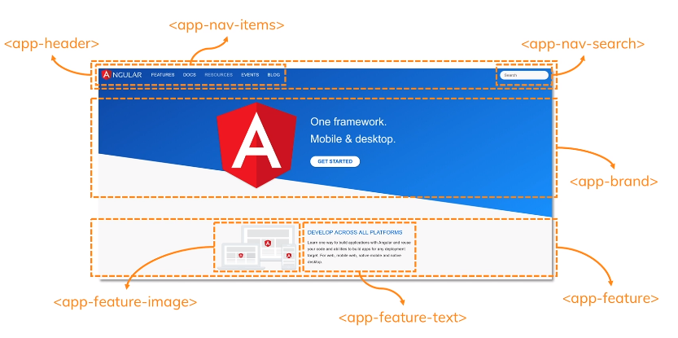

Slide 9
Core Concepts (Data binding)
A mechanism for coordinating parts of a template with parts of a component
Binding Markup added to the template HTML.
Four forms of Databinding syntax:
Template
< >
Event
Binding
{{ value}}
<li>{{myApp.name}}</li>
<app-myApp-detail [myApp]="selectedMyApp">
</app-myApp-detail>
<li (click)="selectMyApp(myApp)"></li>
<input [(ngModel)]=“myApp.name">
[property] = “value”
MetaData
DOM
COMPONENT
Property
Binding
(event) = “handler”
[(ng-model)] = “property”
Component

Slide 10
Core Concepts (Directives)
Angular templates are dynamic. Angular renders templates, it transforms the DOM according to the instructions given by directives.
A directive is a class with a @Directive decorator.
A component is a directive-with-a-template.
@Component decorator is actually a @Directive decorator extended with template-oriented features.
Other directive types:
Structural directives - Alters layout by adding, removing, and replacing elements in DOM.
Built in structural directives
<li *ngFor="let hero of heroes"></li>
<app-hero-detail *ngIf="selectedHero"></app-hero-detail>
Attribute directives alter the appearance or behavior of an existing element.
<input [(ngModel)]="hero.name">
ngSwitch, ngStyle, ngClass are some additional directive types.
MetaData
Directive
{ }

Slide 11
Core Concepts (Services)
Broad Category - Includes any value, function or feature which the Angular application needs
It is typically a class with a narrow, well-defined purpose.
Examples include:
logging service
data service
message bus
tax calculator
application configuration
Anything else
Example of Service : src/app/logger.service.ts
export class Logger {
log(msg: any) { console.log(msg); }
error(msg: any) { console.error(msg); }
warn(msg: any) { console.warn(msg); }
}
Service

Slide 12
Core Concepts (Dependency injection)
It’s a way to supply a new instance of a class with the fully-formed dependencies it requires.
Most dependencies are services
Angular uses dependency injection to provide new components with the services they need.
constructor(private service: MyAppService) { }
Injector
Service A
Service B
myAppService
Service C
Service D
GrandChild A Component { }
GrandChild A
Template < >

Slide 13

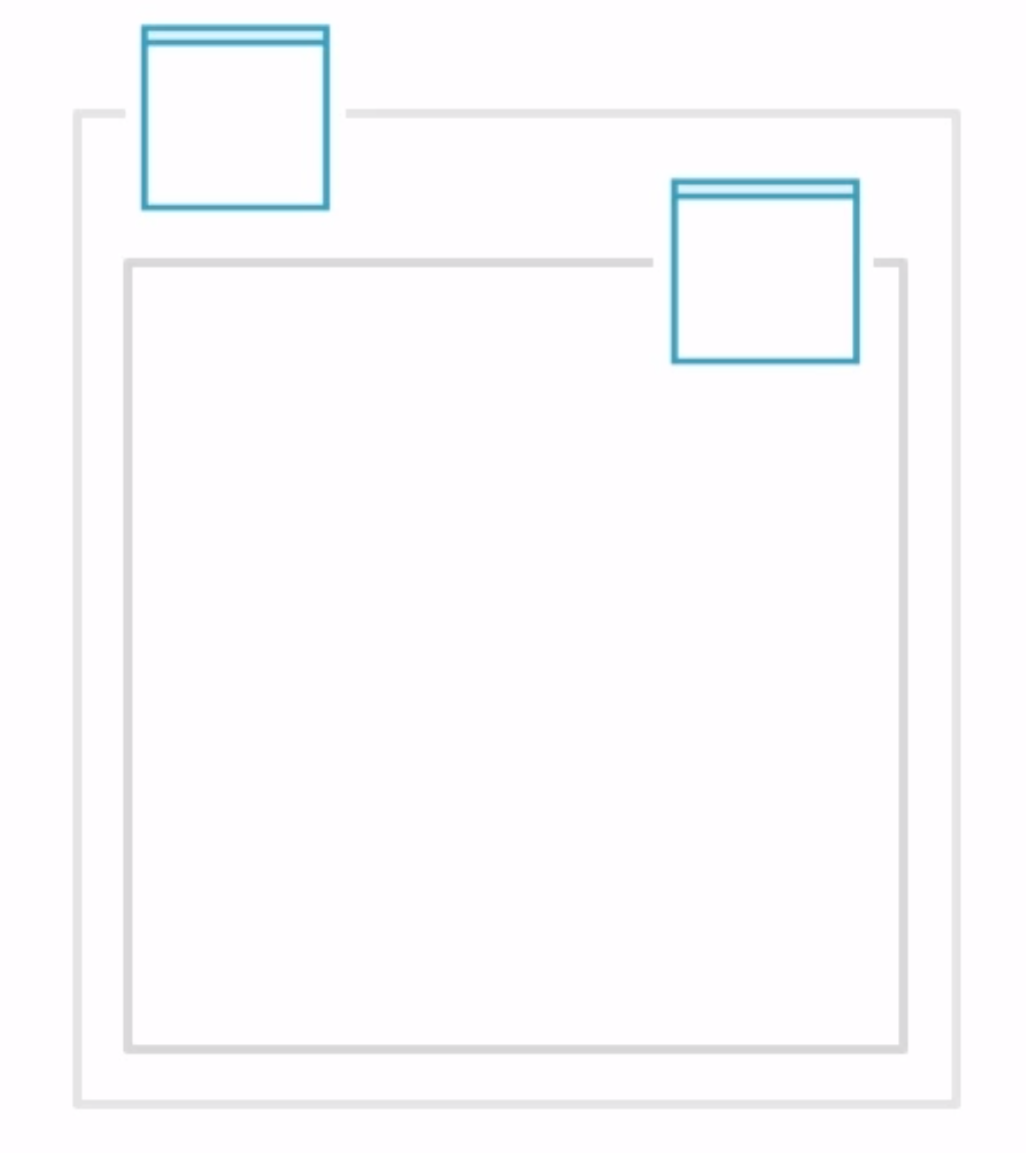
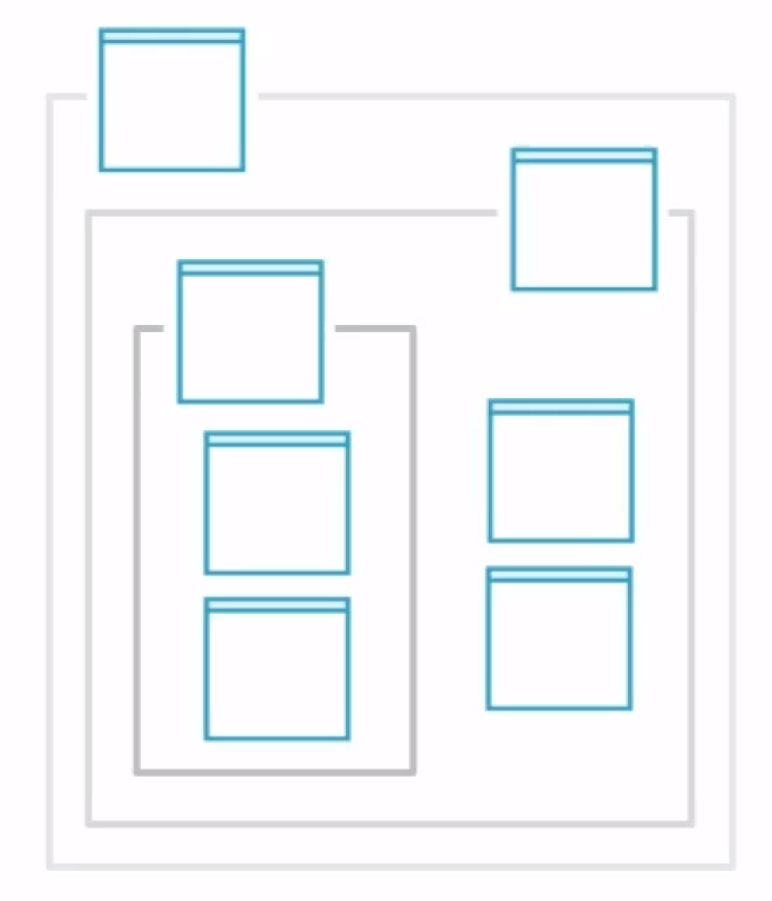
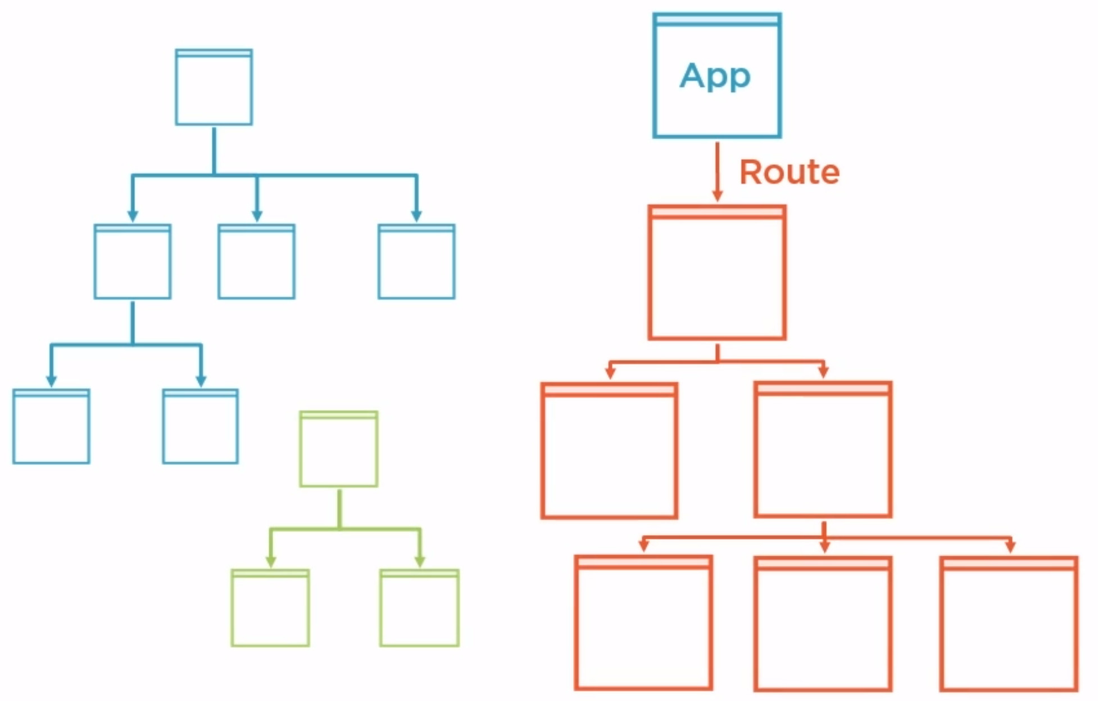
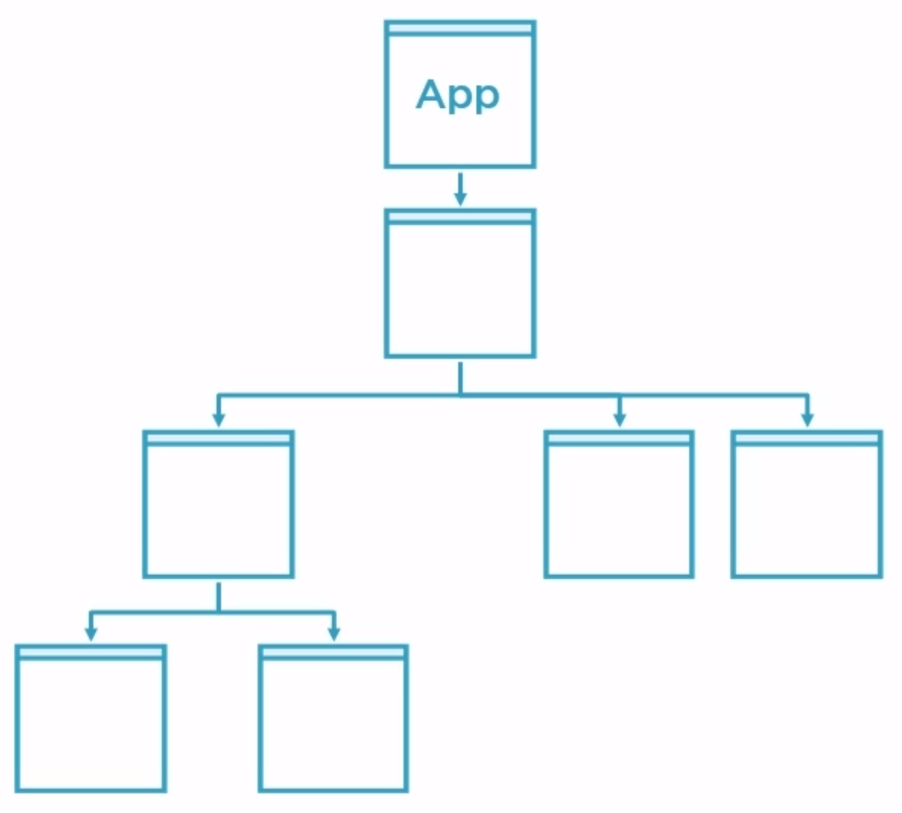
Understanding Angular Component Hierarchy
Router routes to App Component
Smaller nested components loaded
Root APP Component
Router loads newer components based on new routes

Slide 14
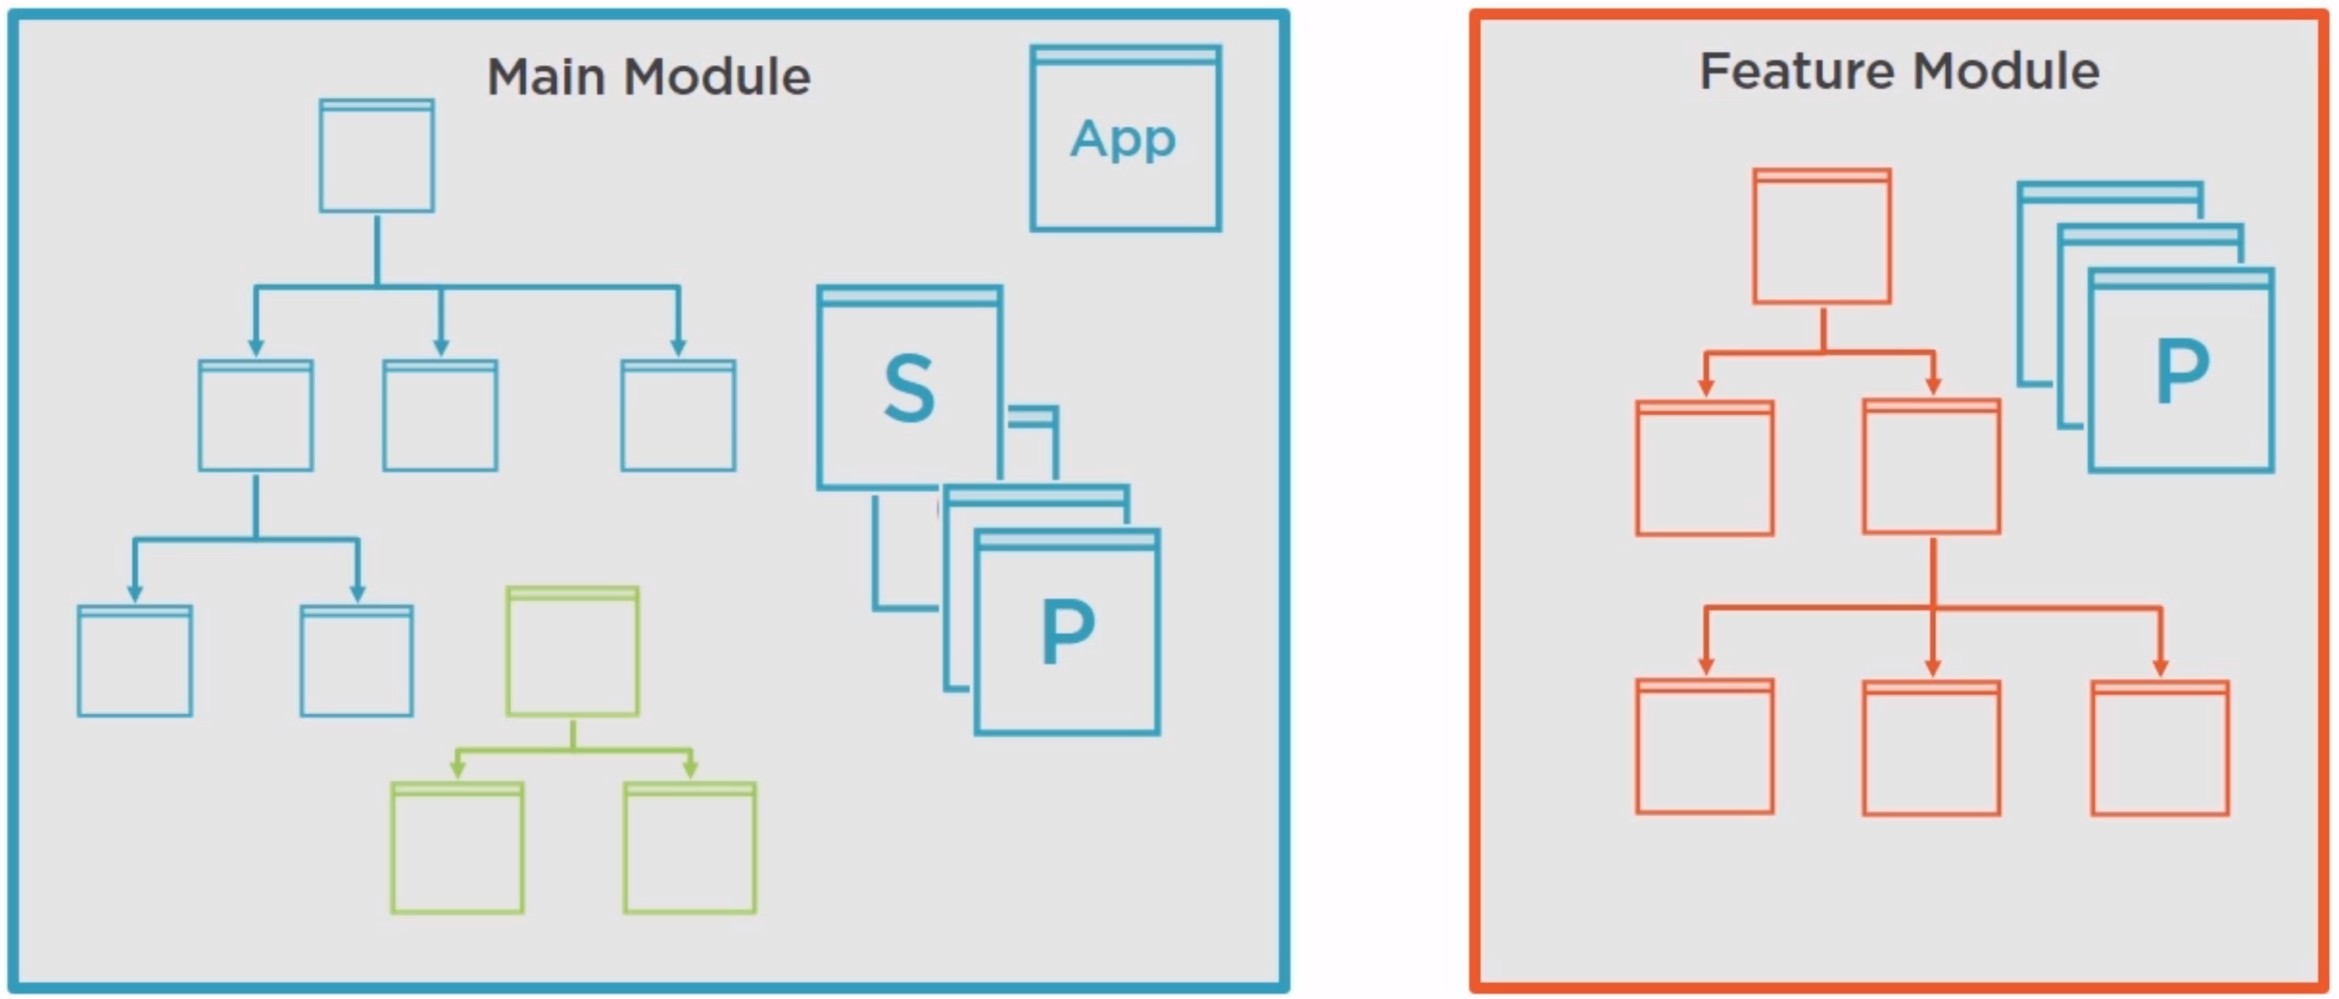
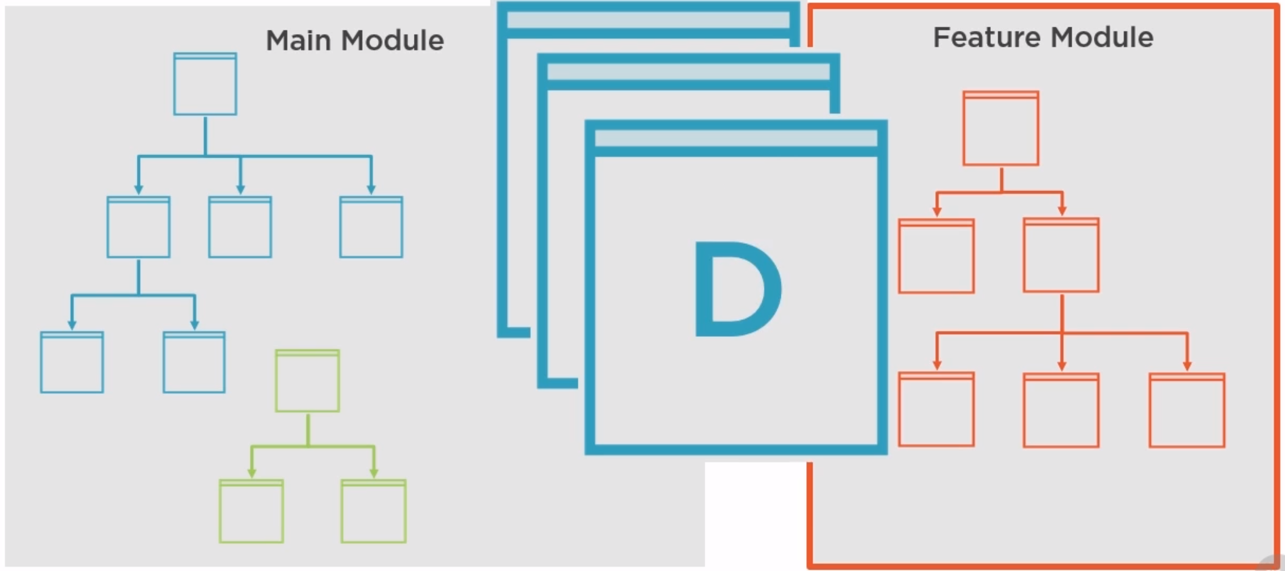
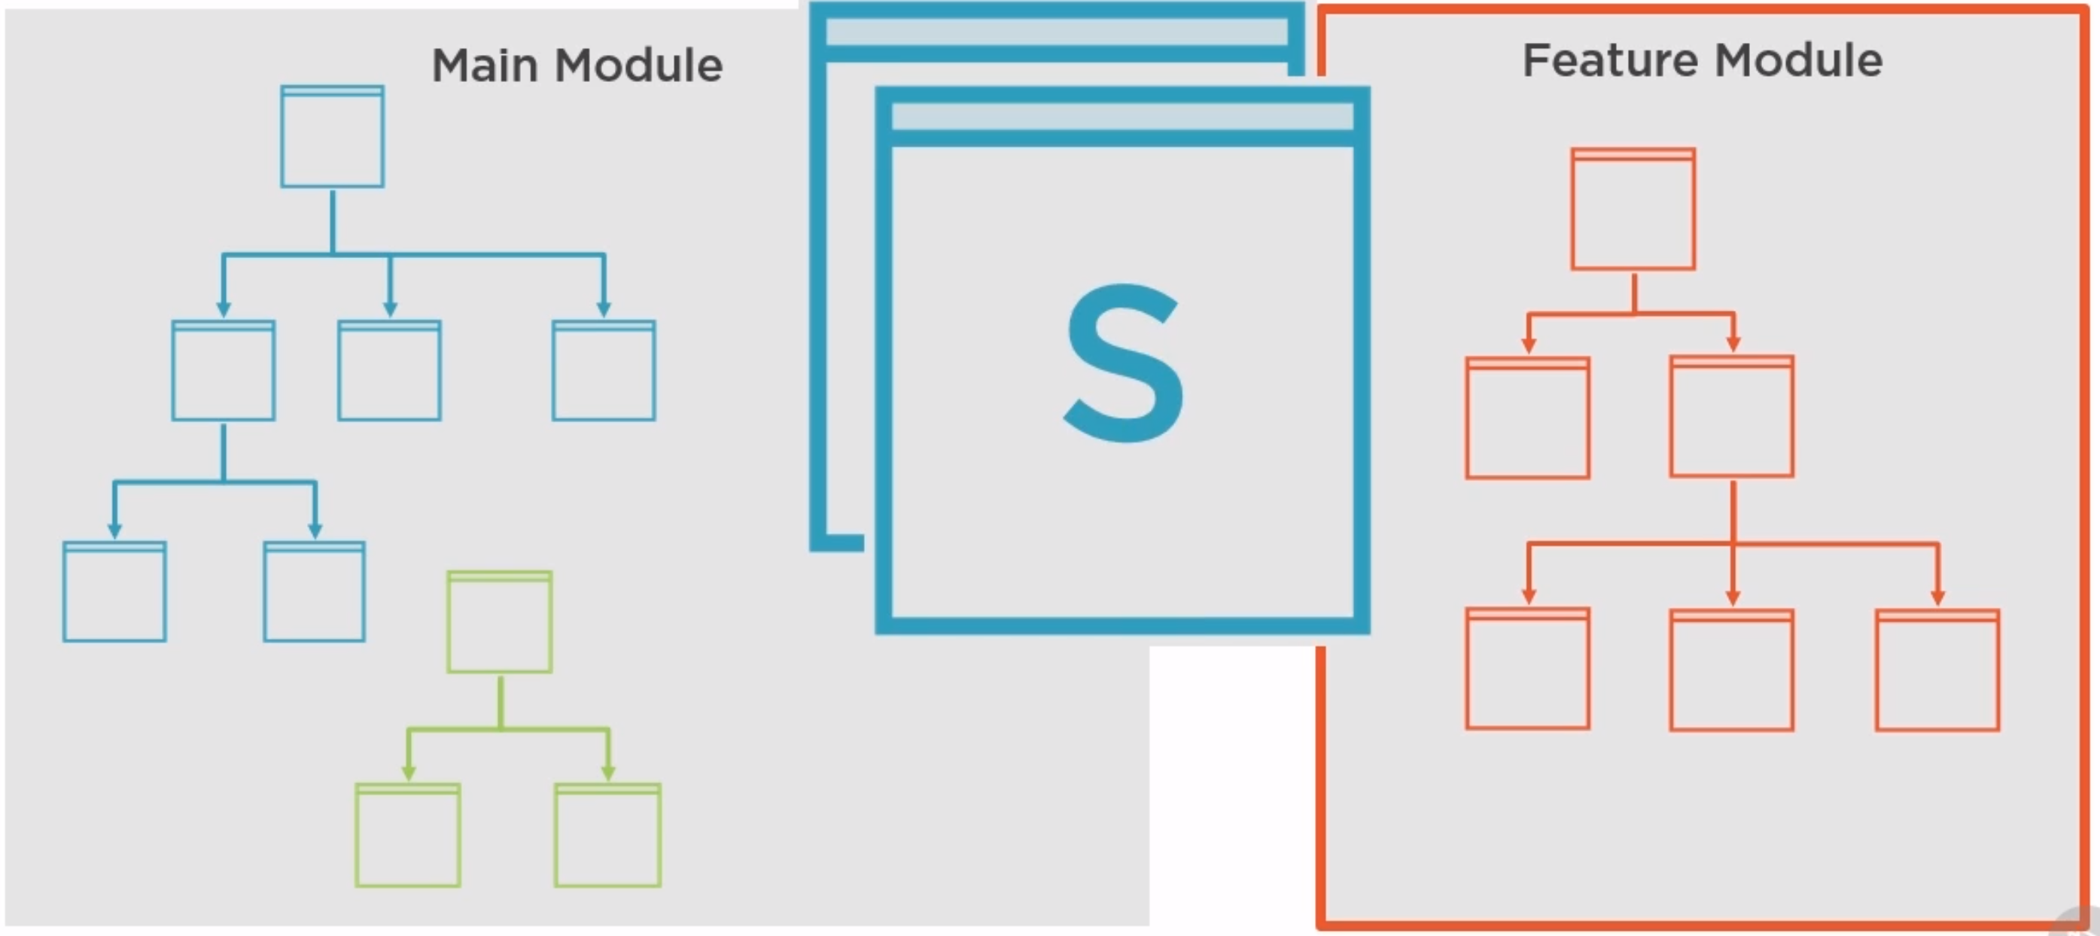
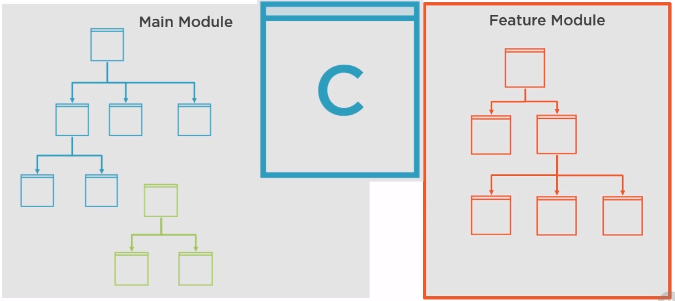
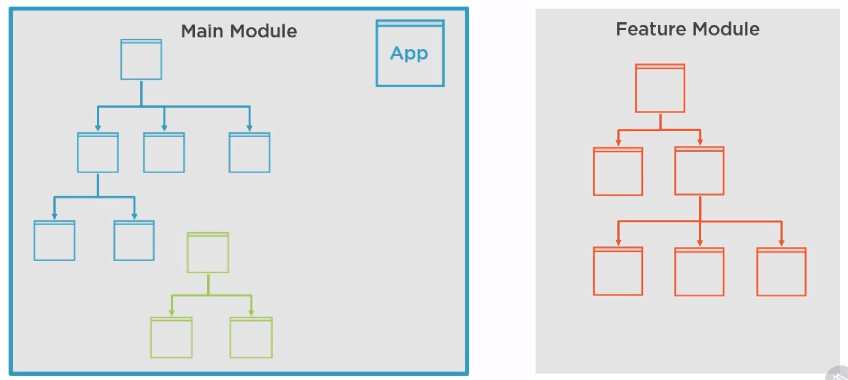
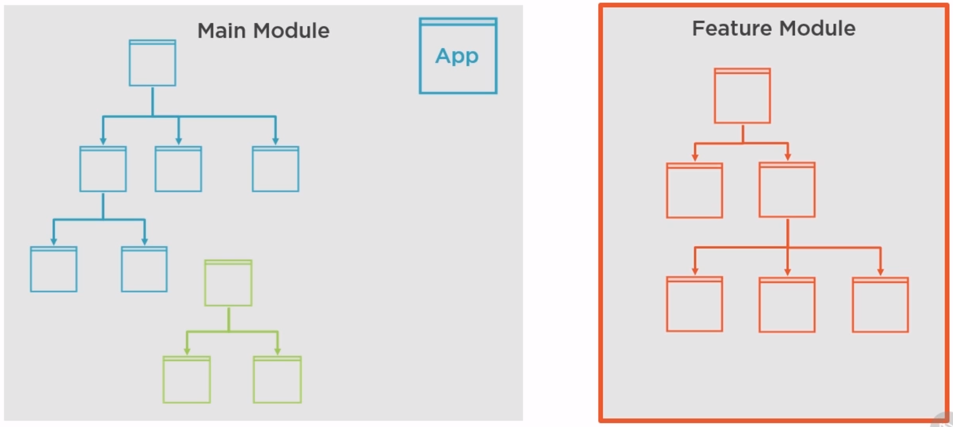
Understanding Angular Module

Slide 15
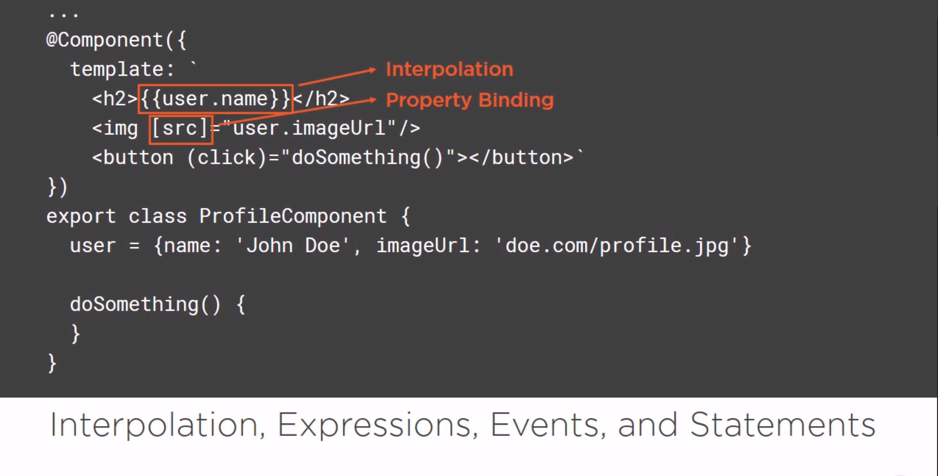

Slide 16
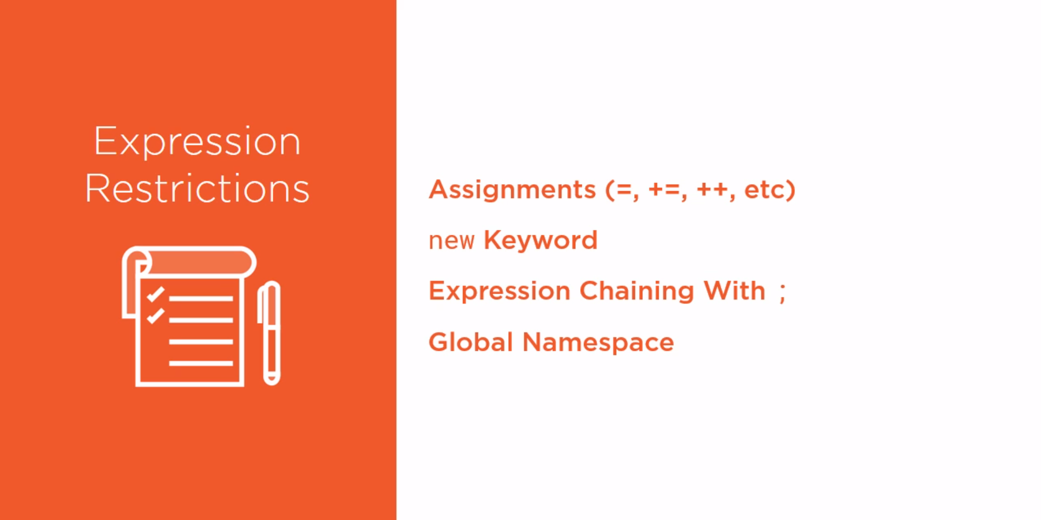

Slide 17
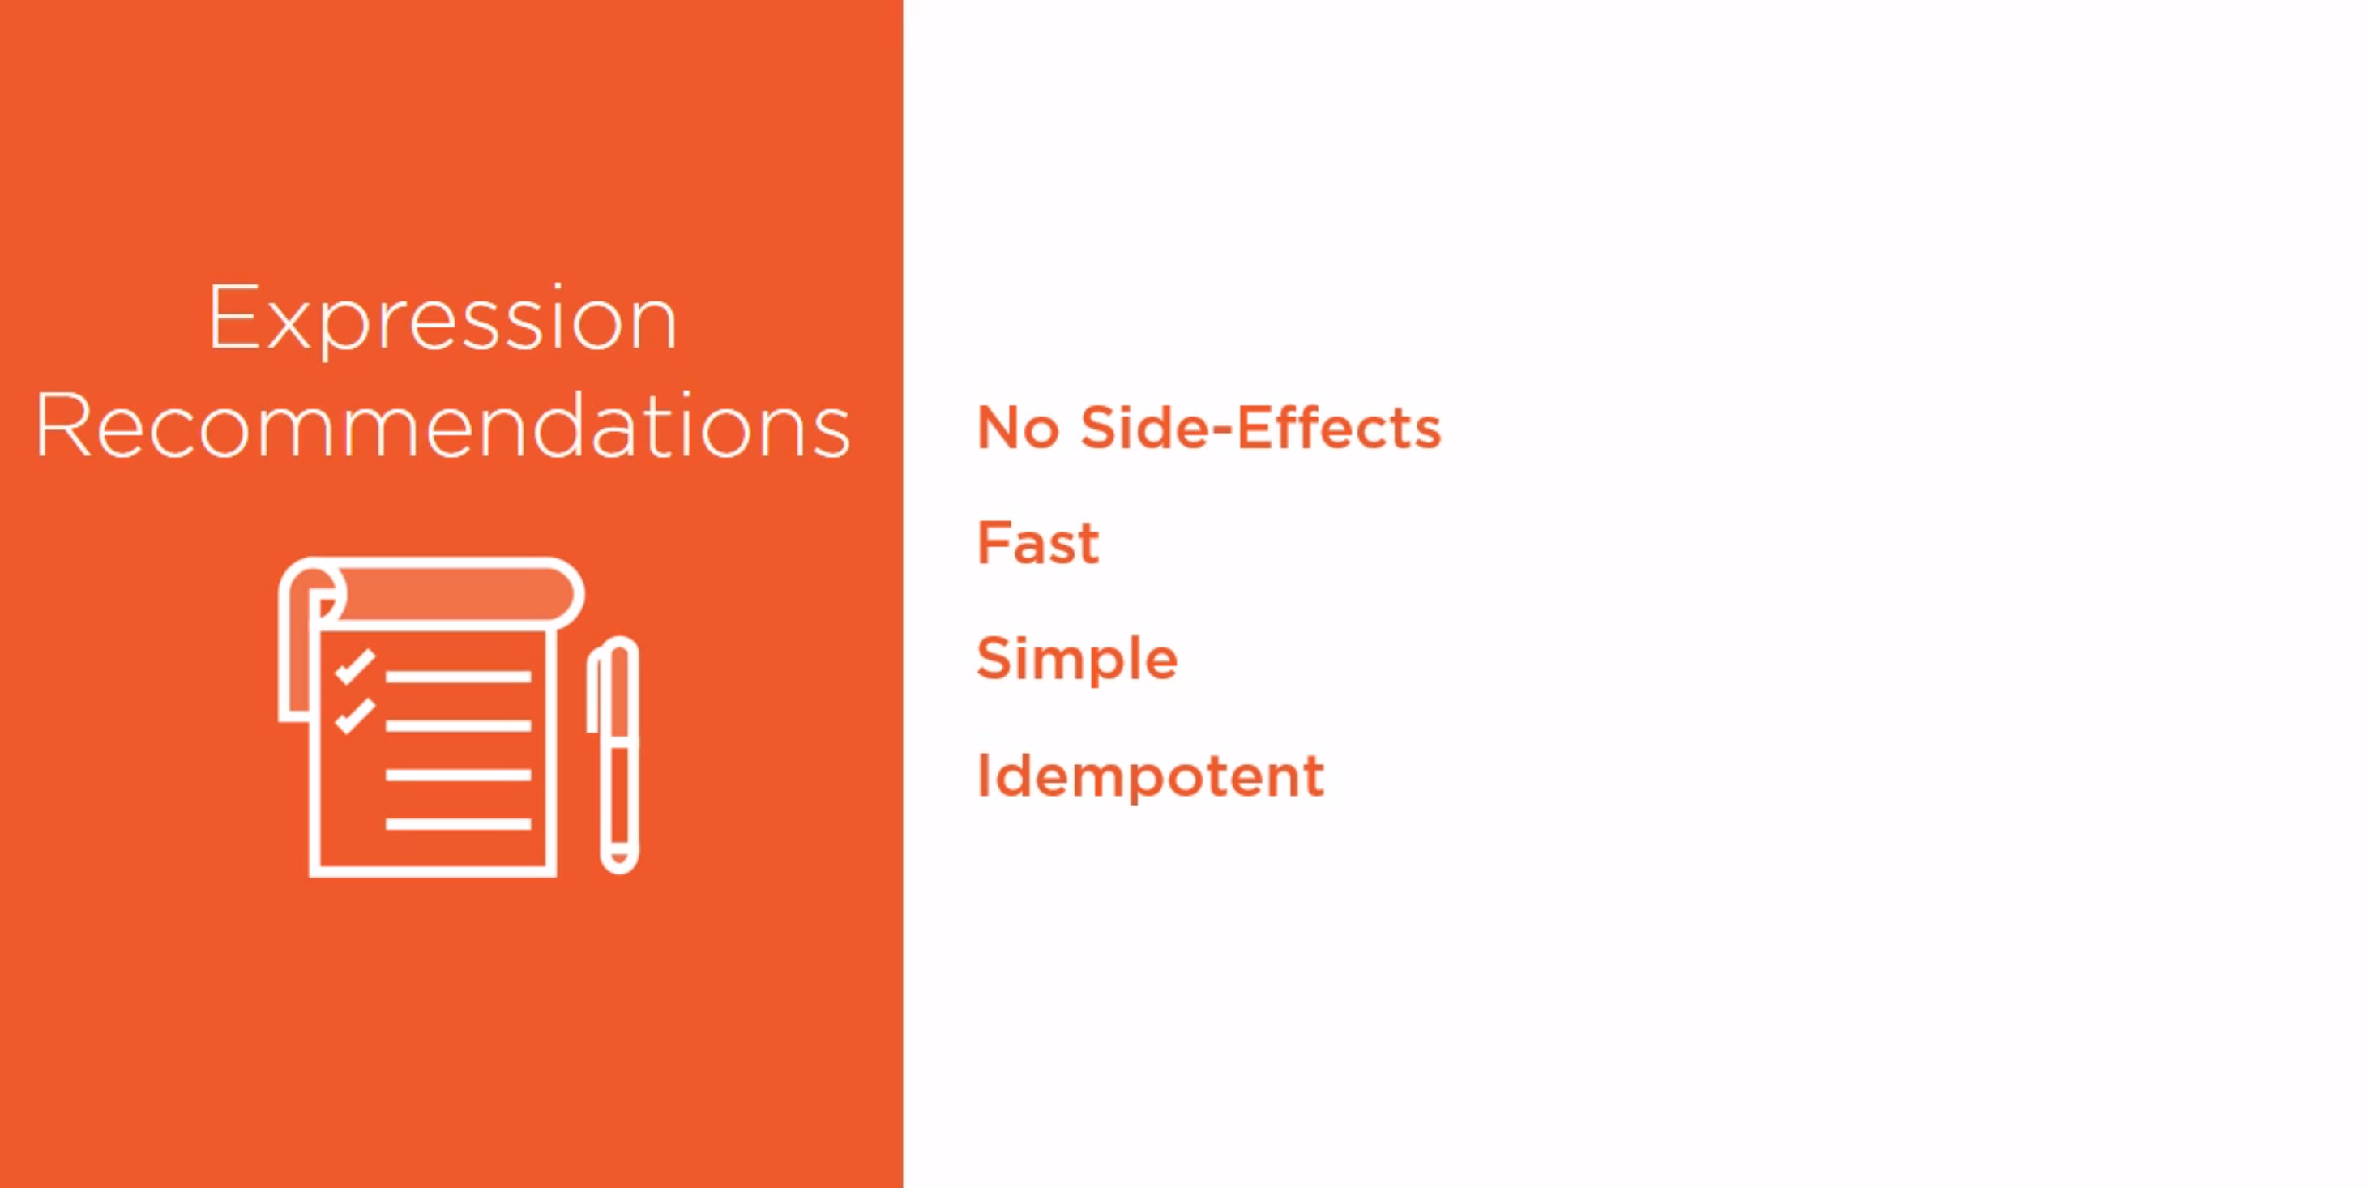

Slide 18
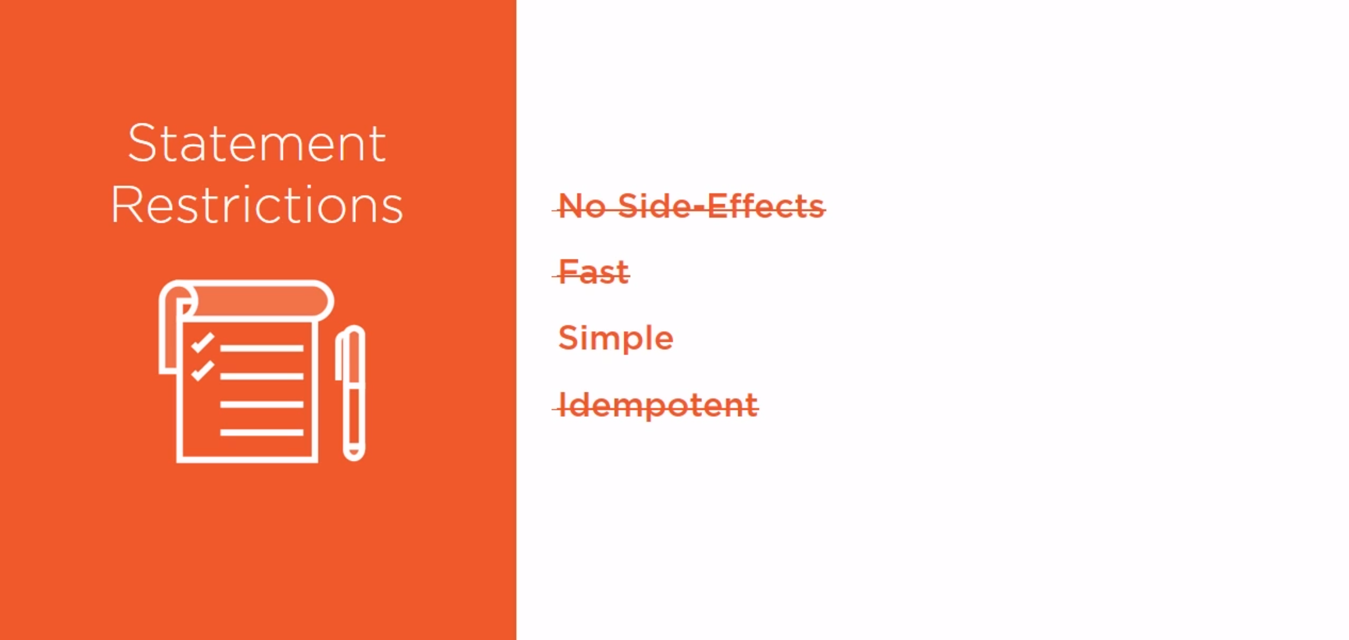
Copyright © 020 Accenture. All rights reserved.

Slide 19
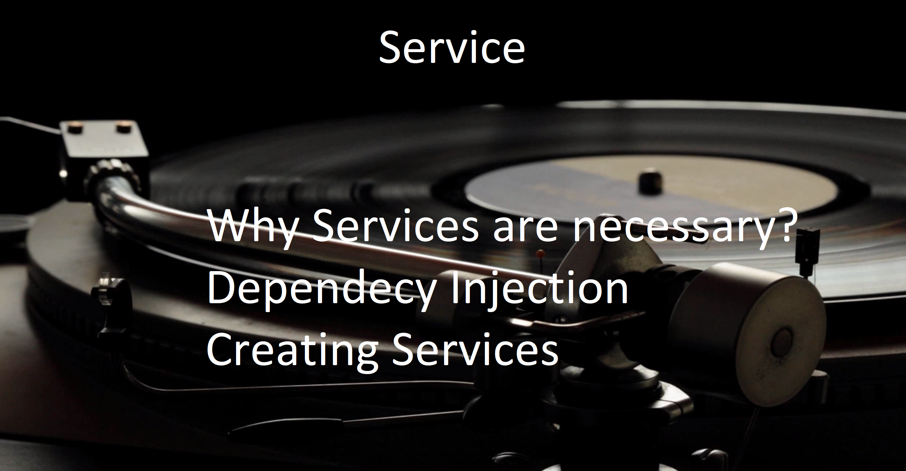

Slide 20
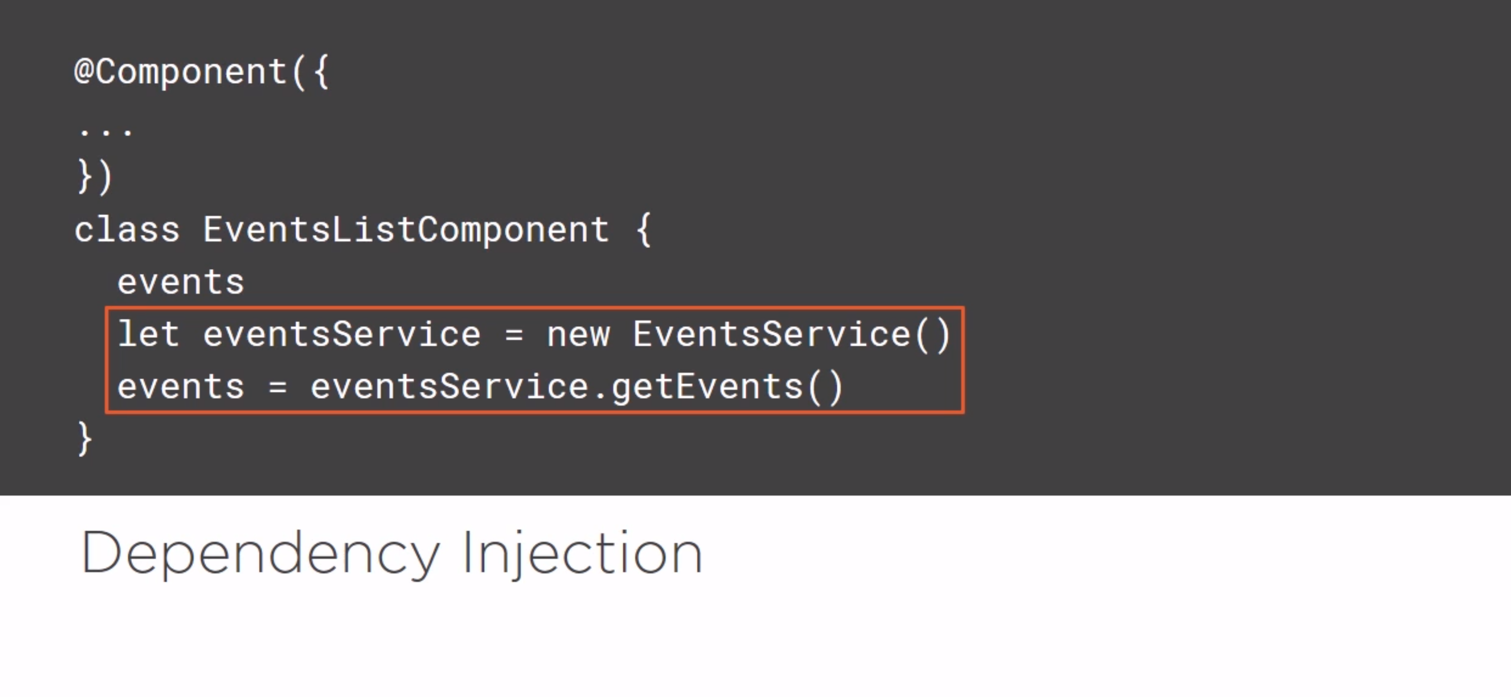
Copyright © 200 Accenture. All rights reserved.

Slide 21
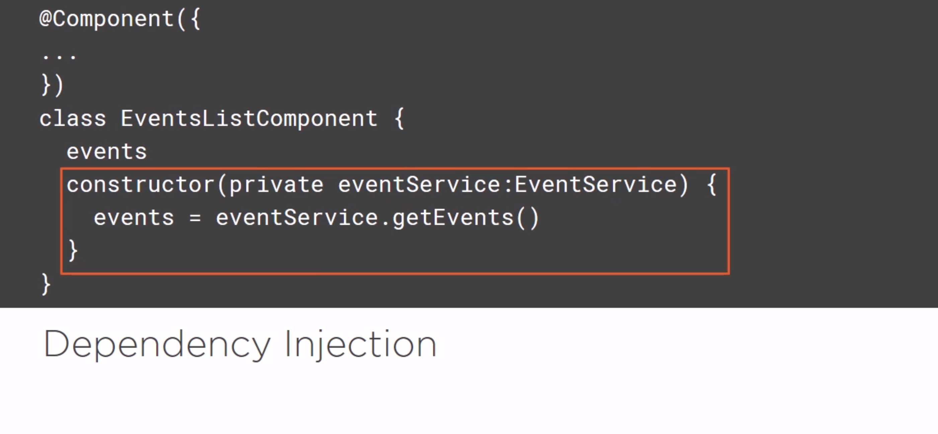

Slide 22
Quiz Time
Go to www.menti.com and use code 34 36 04

Slide 23
Links
Official : https://angular.io/docs
https://www.pluralsight.com/paths/angular
YouTube channel : https://www.youtube.com/watch?v=KhzGSHNhnbI
https://www.edureka.co/blog/angular-tutorial/

